Slide 1
Section 3.3
Residual Plot and Correlation

Slide 2
What is taught in this section?
How do you evaluate how good a regression is?
  1. Use the value of r2 [coefficient of determination] – if r2 is close to 1, then it is a good regression compared to the average line
  2. Use a residual plot – a graph of the residuals [actual y-values – predicted y-values] against the explanatory values
    Our goal is to look for a pattern - if a pattern exist then the regression model is NOT the best
    If a pattern does NOT exist, which means the residuals are random, then the regression is a good model
  3. Find the standard deviation of the residuals
    Have all the residuals in a list (L4) and then do a 1-var. calc of the residual list
    When comparing which regression is best, the smallest standard deviation in residuals indicate a smaller error with predicted values

Slide 3
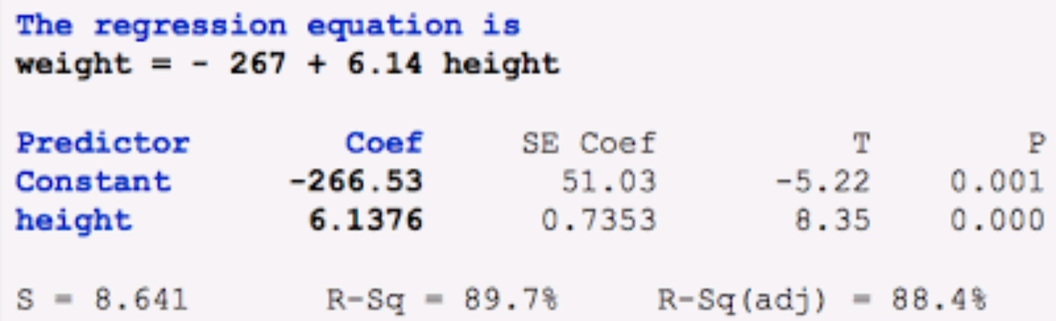
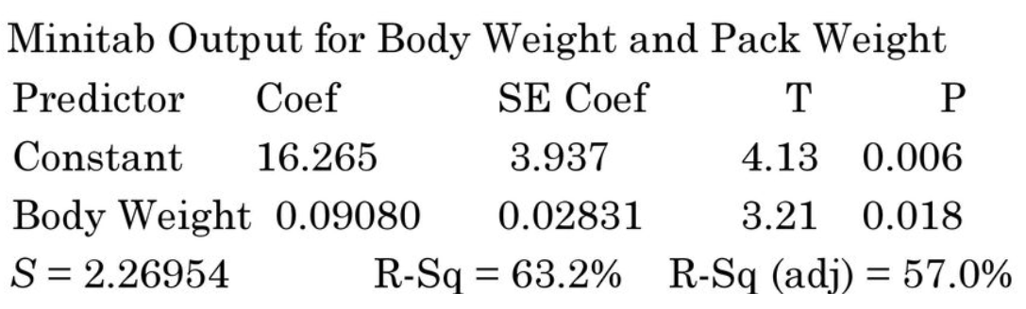
The following minitab output is a LSRL for using height (inch)to predict weight (lbs). Identify & interpret the slope and r² of the LSRL. What is the equation of the LSRL
The following minitab output is a LSRL for using body weight (lbs)to predict a students back pack weight (lbs). Identify & interpret the slope and r² of the LSRL. What is the equation of the LSRL

Slide 4
The following mini-tab output is a LSRL for using height (inch)to predict weight (lbs). Identify & interpret the slope and r² of the LSRL. What is the equation of the LSRL
Slope: 6.1376
For each increase of one unit of the height, the predicted weight will increase by 6.1376 units
R-squared = 89.7%
89.7% of the variation in weight can be explained by the height using the LSRL
Equation of LSRL:
Predicted Weight = -267 + 6.14 x Height

Slide 5
The following mini-tab output is a LSRL for using body weight (lbs)to predict a students back pack weight (lbs). Identify & interpret the slope and r² of the LSRL. What is the equation of the LSRL
Slope: 0.09080
For each increase of one unit of the student’s body weight in lbs, the predicted backpack weight will increase by 0.09080 lbs
R-squared = 63.2%
63.2% of the variation in a student’s backpack weight can be explained by the student’s body weight using the LSRL
Equation of LSRL:
Predicted BACKpack Weight = -0.09080 + 16.265 x Body Weight

Slide 6
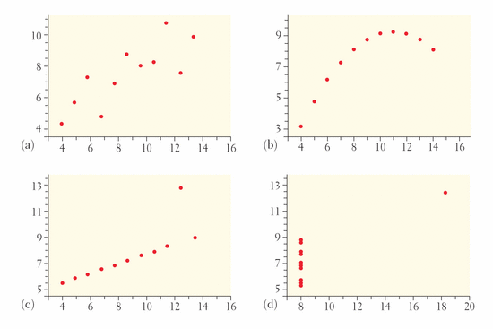
Correlation & Regression Wisdom
Which of the following scatterplots has the highest correlation “r” and “r²”?
ANSWER: ALL four graphs have the same value of “r” of 0.816 and same “R-SQUARED” value
POINT: “r” and “R-SQUARED” alone are not good indicators of the strength of a LSRL
Graph A: Linear pattern
Graph B: Quadratic pattern, definitely not a good model
Graph C: Linear but has a large outlier
Graph D: Not a linear model!

Slide 7
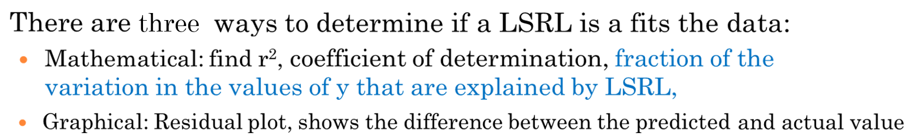
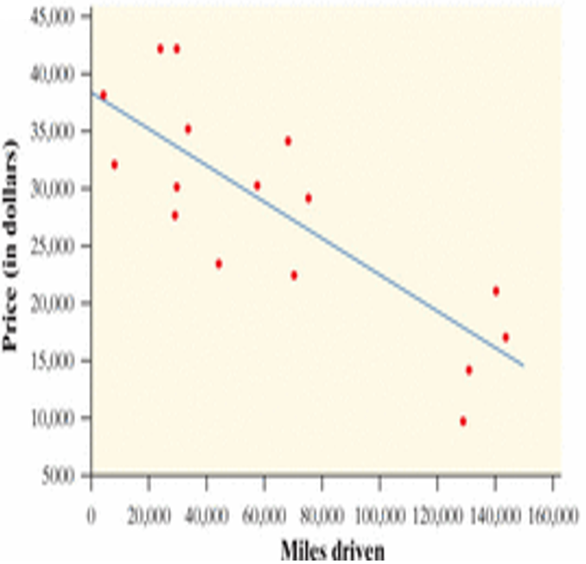
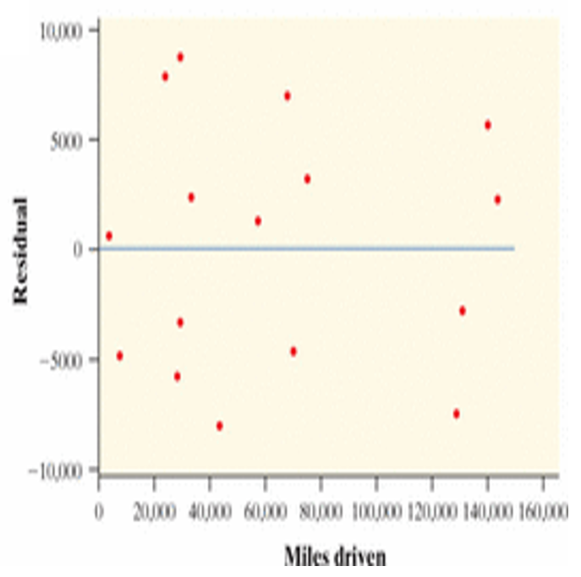
Assessing LSRL (Residual Plots)
The purpose of this section is to assess how good a LSRL is in using “x” to get a predicted ‘y”
The 3rd method is to find the standard deviation of all the residuals from a regression model. A large variation in residual std dev. indicates large prediction errors. A small variation in residual std dev. indicates smaller prediction errors
Scatterplot
Residual Plot

Slide 8
Correlation & Regression Wisdom
ALL the scatterplots shown have the same “r” value of 0.816
Lesson: a numerical value like r or r² is not enough to assess how good a regression model is.
“Residual PLOTs” and “standard deviations of residuals” are two other indicators!

Slide 9
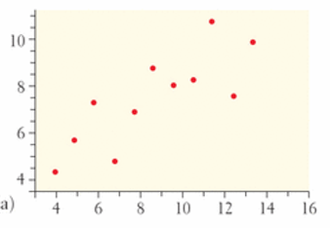
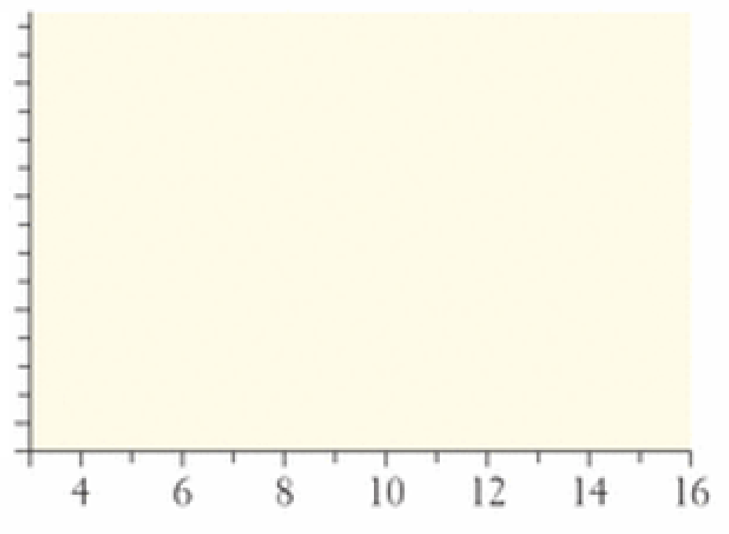
What is a RESIDUAL Plot?
A residual plot turns the LSRL into the middle line
Any data points with a positive residual will be plotted above the “middle line”
Any data point with a negative residual will be below the middle line
LSRL
Residual PLOT

Slide 10
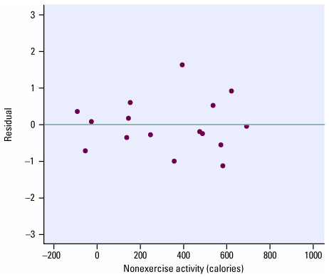
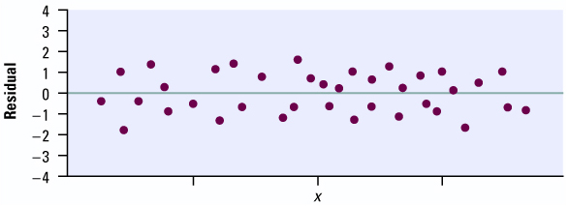
How to USE A Residual Plots
A LSRL is a good model if half the residuals are above and half are below, random, and spread out
This indicates that a linear model and the regression is useful for predicting the y-values
Positive residual → model predictions under estimate
Negative residual → model predictions over estimate
Examples of residual plots for good LSRL
Half and Half!! Line is in the middle!

Slide 11
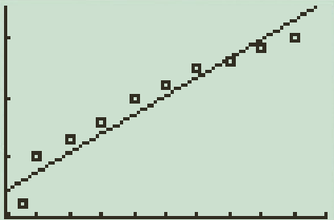
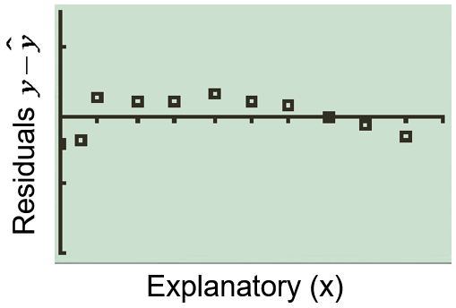
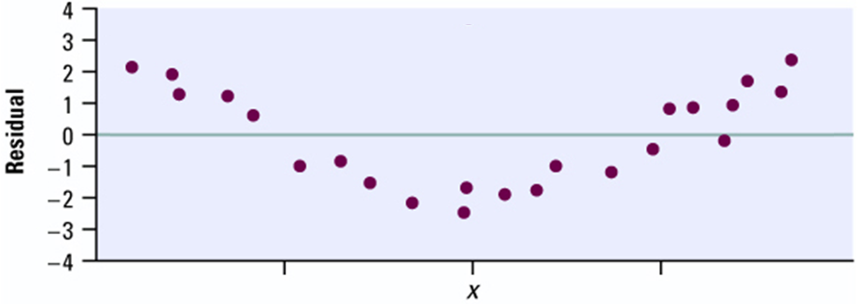
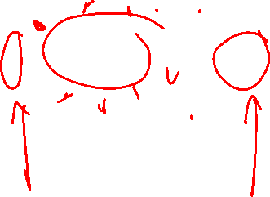
LRSL is a poor fit when Residual Plots show:
If a curved pattern exists then a regression line would be a poor model
This shows that the model will under/over estimate predictions for future years
Scatter Plot & Regression Line
Residual Plot
Response (y)
Explanatory (x)
From the scatter plot, a regression line may seem like a good idea
A curve pattern in the residual plot indicates that a straight line may not
be the best model

Slide 12
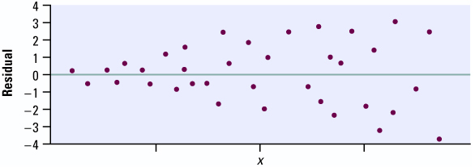
Another Poor fit: Increasing/Decreasing Pattern
Another example of where LSRL would be a poor model is the increasing/decreasing pattern
The residuals increase as “x” gets larger indicating that prediction errors will bigger
Prediction will be less accurate when “x” gets bigger
LSRL will be a poor fit for the data

Slide 13

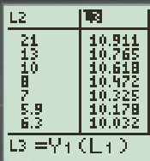


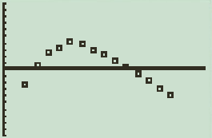
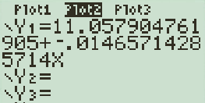

Graphing a Residual Plot (p219)
When graphing a residual plot, have the data entered in L1 and L2
Create the regression line and then set the values in L3
Set the values of the residuals (“y - ŷ”) in L4:
Make the residual plot in “PLOT 2” and set the window size: Xlist – L1 and Ylist – L4
Turn Plot 1 Off
and Plot 2 On
VARS
Functions
1:Y₁

Slide 14
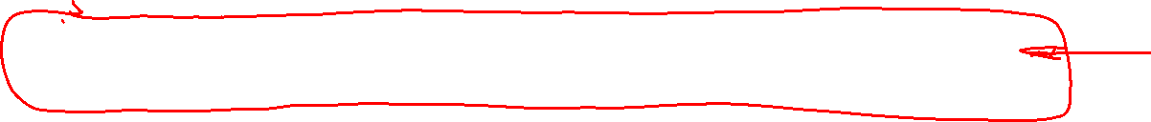
Ex: Does Fast Driving Waste Fuel? P222 #3.42
Speed is measured in km/h and fuel consumption is measured in litres/100km.
a) Make a scatterplot of the observations and draw the least-squares regression line on your plot. Make sure you indicate what your variables are.
b) Would you use the LSRL to predict y from x? Justify your answer.
c) Check that the residuals have sum of zero and find and interpret the standard deviation of the residuals
d) Make a residual plot. What can you conclude from the residual plot?

Slide 15
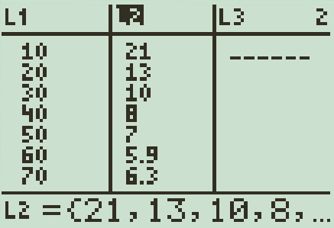
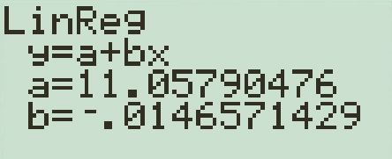

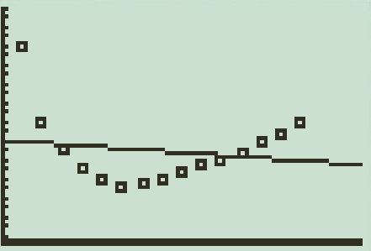

a) Plot the data on a Ti-83 and do a linear regression on the data
Explanatory Variable: Speed of Vehicle in km/hour
Response Variable: Vehicle Fuel consumption in Litres/100km
Remember to turn “Diagnostic On” to get “r” as well
Fuel Consumption vs Speed
b) The LSRL will not a be a good model to predict “y” because of two reasons. 1. the correlation coefficient is very low (0.029), which means only 3% of the variation in fuel consumption is explained by the LSRL of fuel on Speed. 97% of the variation is from other factors. 2nd the scatterplot clearly shows a non-linear relationship
Fuel (L/100km)
Speed (km/h)

Slide 16
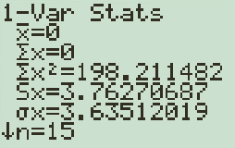
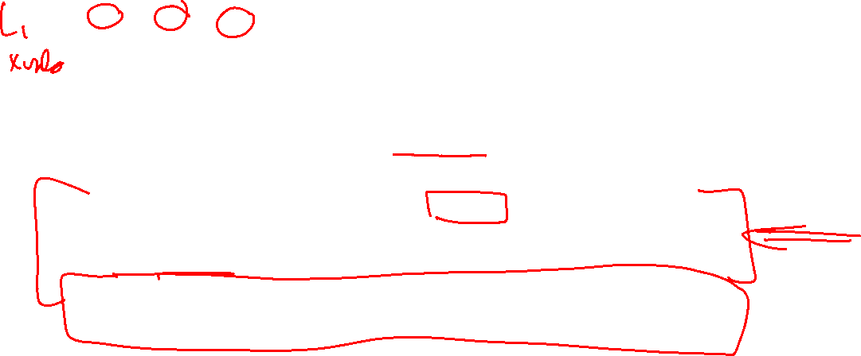
c) Use the Ti-83 to find the residuals and the sum of the residuals:
i) Set L3 as the predicted values “ ŷ ”. L3 = Y₁(L₁).
ii) Make L4 the residuals “y - ŷ”: L4=L₂ - L₃
iii) Use “1-Var Calc” to find the sum: 1-Vars Stats L₄
Sum of
residuals
is equal to
zero
The standard dev. of the residuals is 3.635. This means that our predictions for fuel consumption (L) based on speed will typically be off by 3.635. (363.5L/100km)
A large standard error like this would indicate that the LSRL is a poor model of this data.

Slide 17
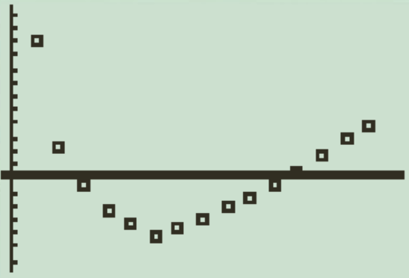
d) The residual plot shows a clear curved pattern. This also indicates that the LSRL is a poor model. The regression line underestimates fuel consumption for slow and fast speeds. Yet, overestimates fuel consumption for moderate speeds.
Fuel (L/100km)
Speed (km/h)
The curved pattern seen here in the residual plot indicates that it is a poor model for this data set. Our fuel consumption predictions will be underestimated for high speed.

Slide 18
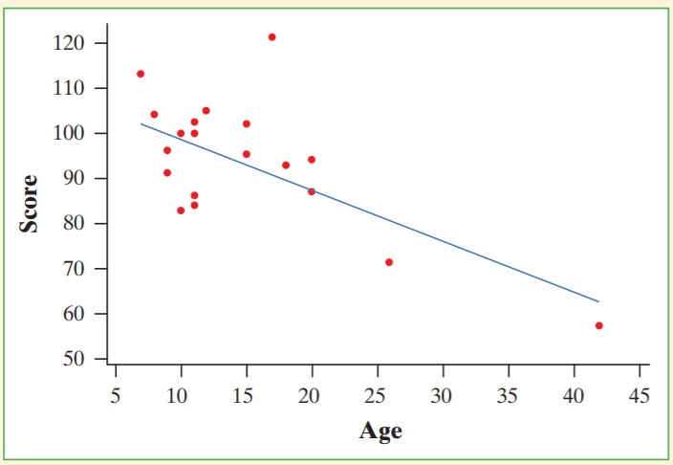
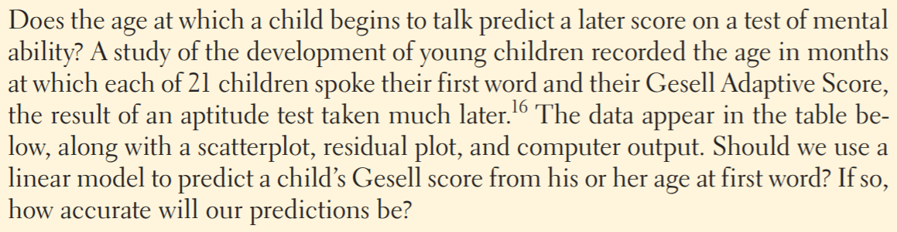
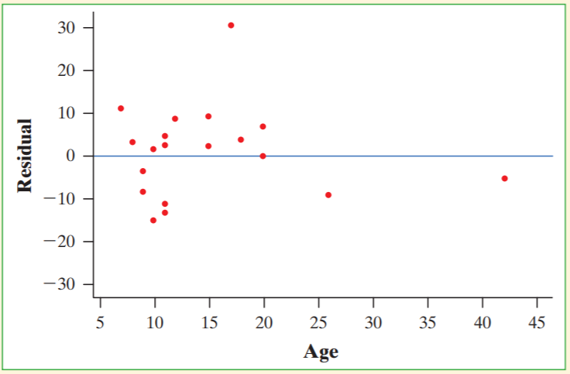
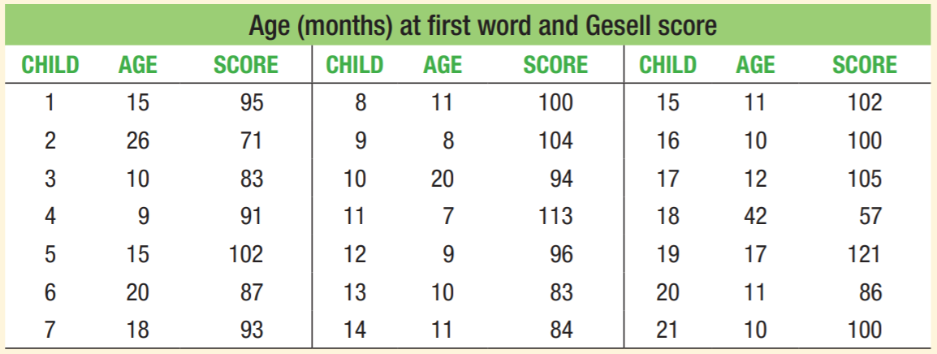
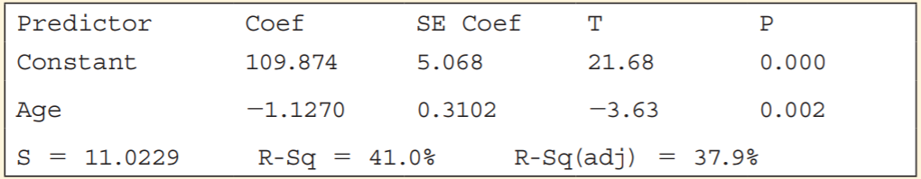
Q: Determine if a linear model is a good fit for this data. Justify your answer using the residual plot, r2, and std of residuals
Q: What association does the scatterplot show between “age a child begins to talk” vs “Geselle Score”. Explain
Q: What conclusions can you make?

Slide 19
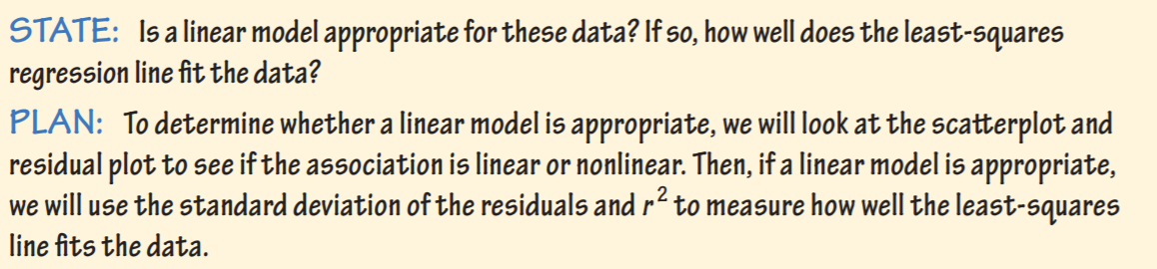
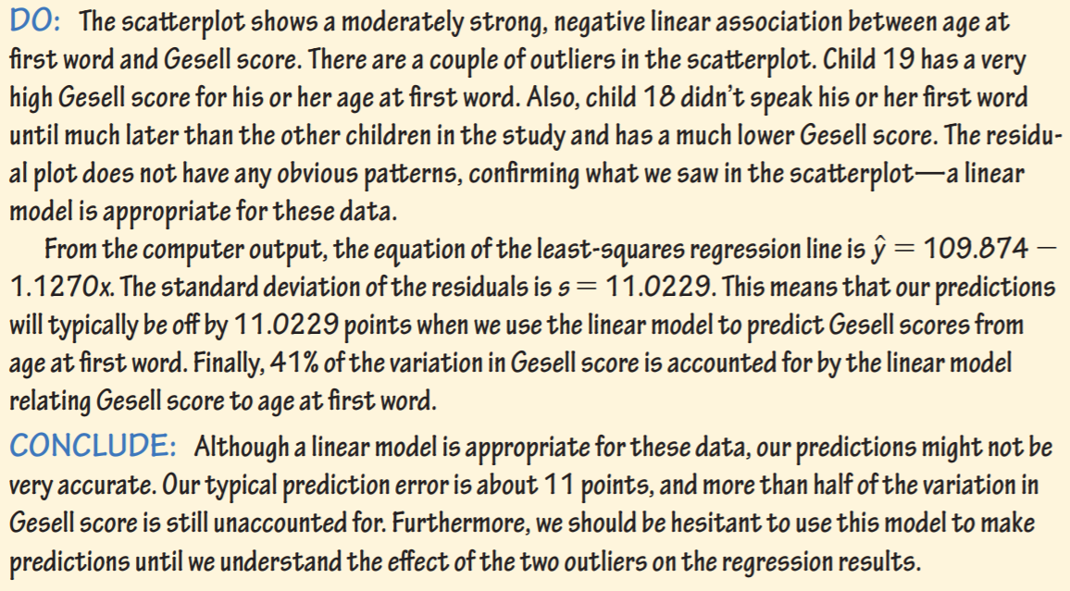

Slide 20
Outliers and Influential Observations
An outlier is an observation that lies outside the overall pattern of the other observation.
All influential points are outliers, but not all outliers are influential points.
An observation is influential for a statistical calculation if removing it would markedly change the result of the calculation.
Points that are outliers in the x directions of a scatterplot are often influential for the least-square regression line
Influential points/observations: If removed would significantly change LSRL (slope and/or y-intercept)

Slide 21
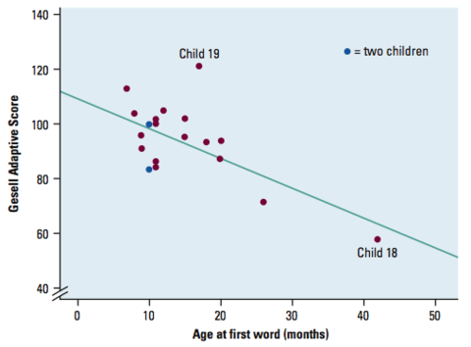
Definitions: Outliers & Influential Points
Outlier: observations with large residuals within our data range
Child 19 is an outlier. From the prior example we can see that “r” and “r2” were quite low. Heavily affected by outliers
Influential/extreme points are data points that have “x” values much larger than most of our data points.
Child 18 is an influential/extreme point

Slide 22
Once again, an association can occur between two variables but have no causation between them
Two variables below: “Number of Methodist Church” and “The amount of Rum Import” show a positive correlation
Year | Number of Methodist Ministers in New England | Cuban Rum Imported to Boston (in # of barrels)
1860 | 63 | 8,376
1865 | 48 | 6,506
1870 | 53 | 7,005
1875 | 64 | 8,486
1890 | 85 | 11,265
1900 | 80 | 10,547
1915 | 140 | 18,559
A positive correlation does not imply any causation at all
Both values are just increasing over time, so “time” is the lurking variable here…..

Slide 23

Lurking Variables
Lurking variables are usually unnoticed, they are neither the explanatory or response variable
Instead it’s a variable that affects both the explanatory and response variables
Lurking variables makes others assume that there is a causation effect between Explanatory and Response var.
Example: a boy sitting in a plane and complains to his mom that he hopes that they will stop turning on the warning lights. Each time the light goes on, the plane goes on a bumpy ride
Note: the kid creates a false causation → lights makes ride bumpy
Turbulence is the lurking variable
4.3 Will discuss Lurking variables
Turbulence
Turbulence
*!# Can they stop turning on the light. It shakes the plane everytime $%%

Slide 24
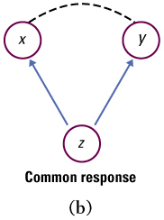
Watch for lurking variables. These are variables that exist outside of the study that may have an effect on the explanatory and/or response variable(s).
i.e. Students who have high SAT scores tend to have high grades in college.
We can not conclude that SAT scores cause high college grades, because a lurking variable, namely intelligence, is present. This lurking variable affects both SAT scores and grades. This is an example of common response, where the lurking variable creates and association.
Lurking Variables (Common Response):
Changes in both “x” and “y”
are caused by changes in a
lurking variable “z”

Slide 25
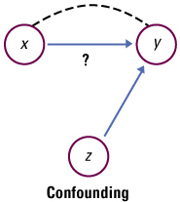

Confounding occurs when the effects of variables can not be distinguished from one another.
i.e. Being active in their community, these people tend to live longer.
We can not conclude that community participation causes an increase in life span. This is because active people also tend to exercise more, eat better, and take better care of themselves. We can not distinguish the effects of community participation vs active healthy leaving on living longer
Confounding:
The effects of “x” on “y” vs the effects of
confounding variable “z” on “y” is
indistinguishable.
“x” and “z” may have an association. Both have an indistinguishable affect of “y”

Slide 26
Ex: In the late 2000, a study was done to find any association between violent video games and violent children. Which statements below is an example of having a lurking variable?
a) Most kids tend to have aggressive tendencies. Playing video games allow kids to vent that aggression.
b) Kids who play violent video games tend to be rich. Rich kids are more spoiled and have violent tendencies
c) Kids who play violent video games tend to act out what they see.
d) Kids who are anti-social tend to play violent video games and may tend to act out violently

Slide 27

In the following scenarios, discuss possible cautions that you would apply before concluding causation. Use specific language (lurking variables, confounding, reverse effect, etc.)
1. People who use artificial sweeteners in place of sugar tend to be heavier than people who use sugar. Does this mean that artificial sweeteners causes weight gain?
2. Children who watch many hours of television get lower grades in school.
3. A study finds that students who enroll in an SAT preparation course raised their SAT scores when taking it the second time. Does taking the prep course improve SAT scores?
4. Does having more cars make you live longer? A serious study found that people who own two cars live longer than people who own only one car. A positive correlation exist between the number of cars “x” and length of life “y”.
5. Highly educated people have higher income.
6. BMI (Body Mass Index) is measured in boys aged 9-12. A
correlation is established between the boys’ BMI and their
fathers’ BMI

Slide 28

Solution:
1. Reverse Effect: The effect may be in the opposite direction. People who are overweight in the first place may use artificial sweeteners rather than sugar so that they can lose weight.
Lurking variables like obesity is also plausible.
2. Lurking. Children who don’t care about school or from lower socio-economic background may tend to watch many hours of television and get lower grades as well. Watching too much TV and lower grades may be contributed by lurking variables like not caring and lower socioeconomic backgrounds.
3. Confounding. The effects of the SAT course and the “experience” with taking the SAT the second time may be confounded. A student who has taken the SAT test once may improve on the second attempt because of increased familiarity.

Slide 29

4. Lurking variable/Common Response: People who can afford more cars are wealthier. They can live longer because they can afford better medical care and eat healthier.
5. Confounding can be present. People who have high ability/come from prosperous homes are more likely to get many years of education than people who are less able or poorer. Many of these with high ability/rich can earn a high income despite their education. Can’t conclude that higher income is well-educated people is “caused” by their education
6. Lurking Variables may be present. Although a parent’s body type can affect their children’s through heredity, other factors such as diet and exercise also influence BMI.

